Slide 1
NEARLY NEW NAUTICAL
ANALYSIS OF FACTORS AFFECTING VIEWS OF ADVERTS

Slide 2
Background
Nearly New Nautical is a website that allows users to advertise their used boats for sale. The marketing team is preparing a weekly newsletter for boat owners. The newsletter is designed to help sellers to get more views of their boat, as well as stay on top of market trends. The Head of Marketing has laid out an ambitious goal of increasing the number of readers by 75% this year.
Question
Do the most expensive boats get the most views?
Are there common features among the most viewed boats?

Slide 3
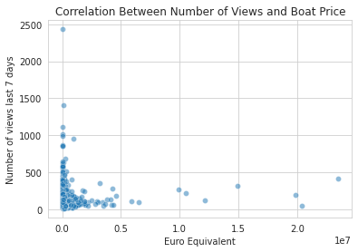
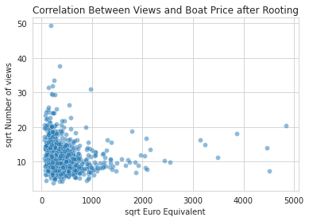
As indicated by the graph below, the cost of a boat does not hugely influence the number of views it gets.

Slide 4
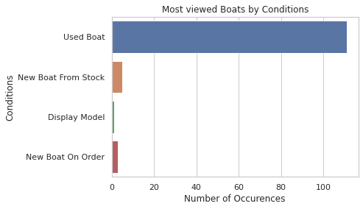
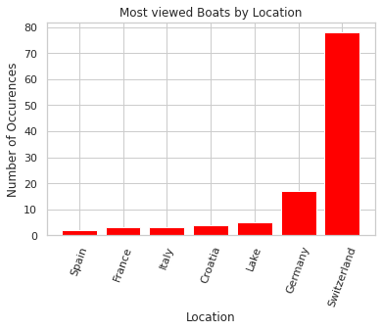
Looking at boats averaging 100 or more views per day, we can see infer the following:
Most customers viewed used boats much more than boats in other conditions.
Boats listed in Switzerland were viewed overwhelmingly more than other boats.

Slide 5
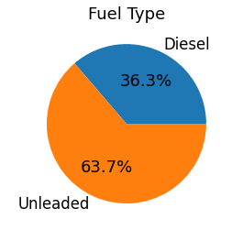
Only boats that used either unleaded fuel or diesel were viewed, at least, 100 times daily.

Slide 6
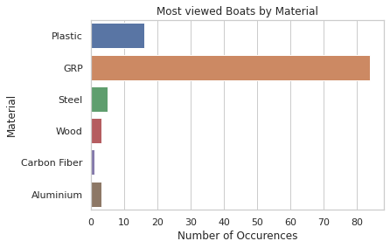
Boats made with Fibreglass (GRP) were preferred by most customers.
Also, although there were not many advertised boats made with Plastic relative to other materials (77), boats made with plastic were more likely to average, at least, 100 viewed daily than to other materials (other than GRP).

Slide 7
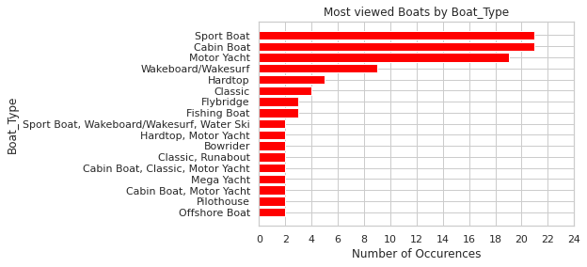
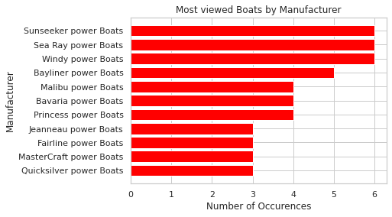
Sport Boats, Cabin boats and Motor yachts were viewed more than other types of boats although the distribution of the type of boat was not as skewed as the other factors.
It’s worth noting that these three (3) types of boats were also massively featured in combinations with other boat type features.
However, the customers did not care about the manufacturer of the boat as shown in the graph.

Slide 8
RECOMMENDATION
To increase customer views:
List more Used boats.
Advertise boats made with Fiberglass (GRP) and possibly Plastic material.
Post boats that use either Unleaded Fuel or Diesel.
Target the Swiss demographic.
A Used Boat made with Fiberglass/Plastic that uses Unleaded Fuel/Diesel located in Switzerland would likely generate more views than any other combination.

